Slide 1
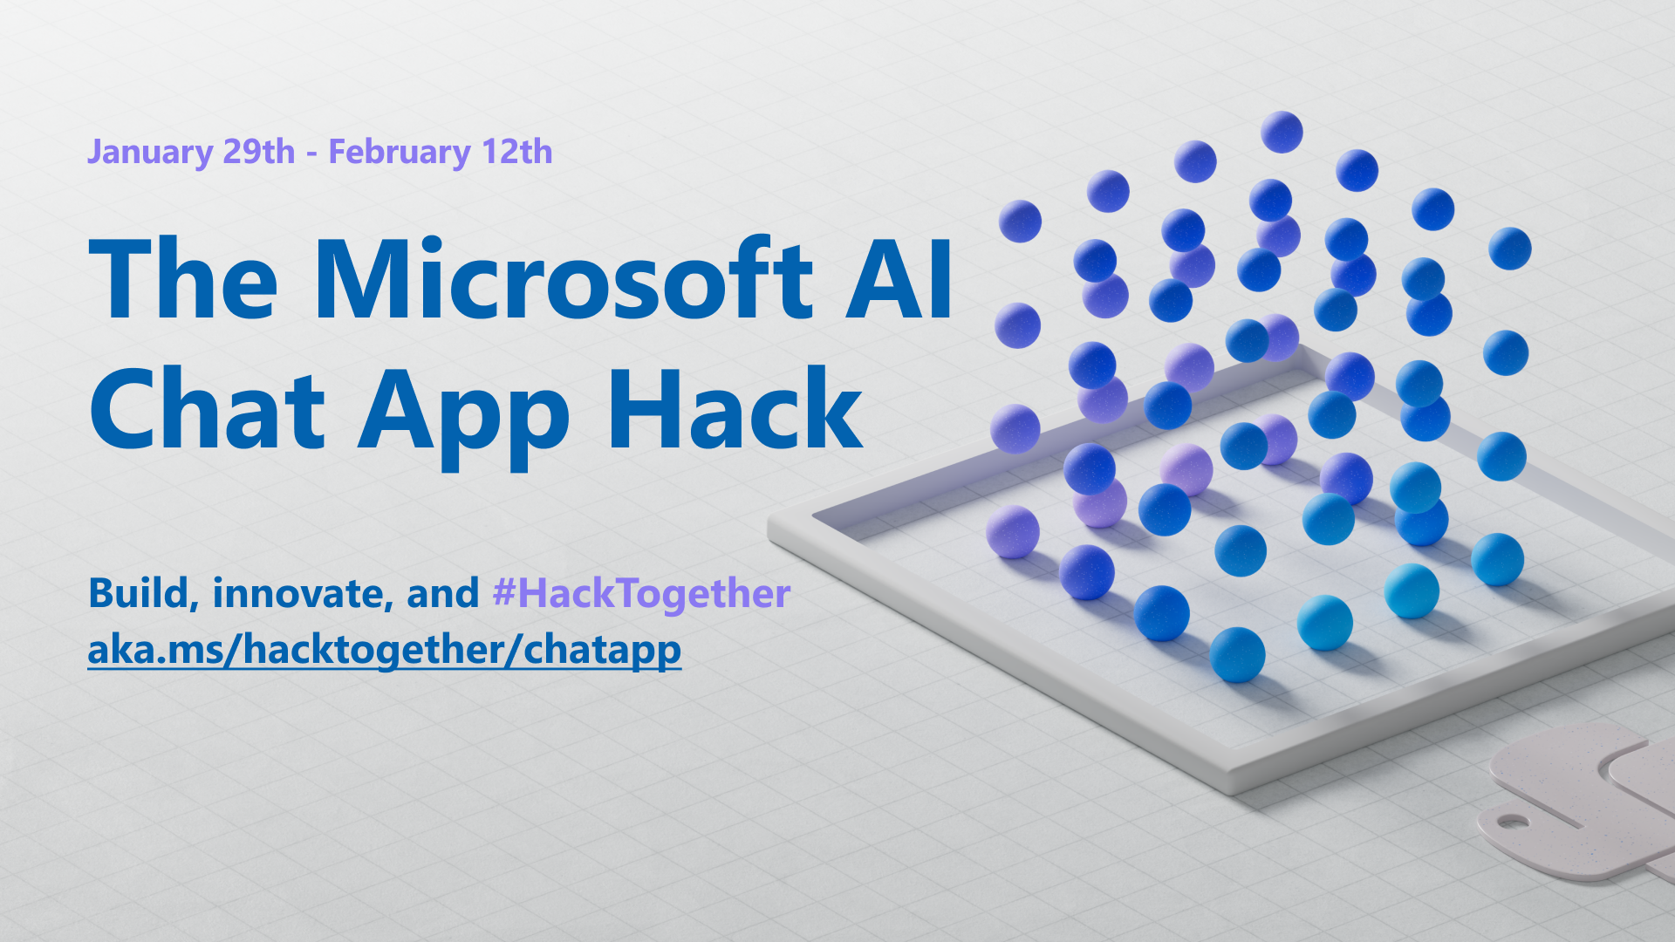

Slide 2
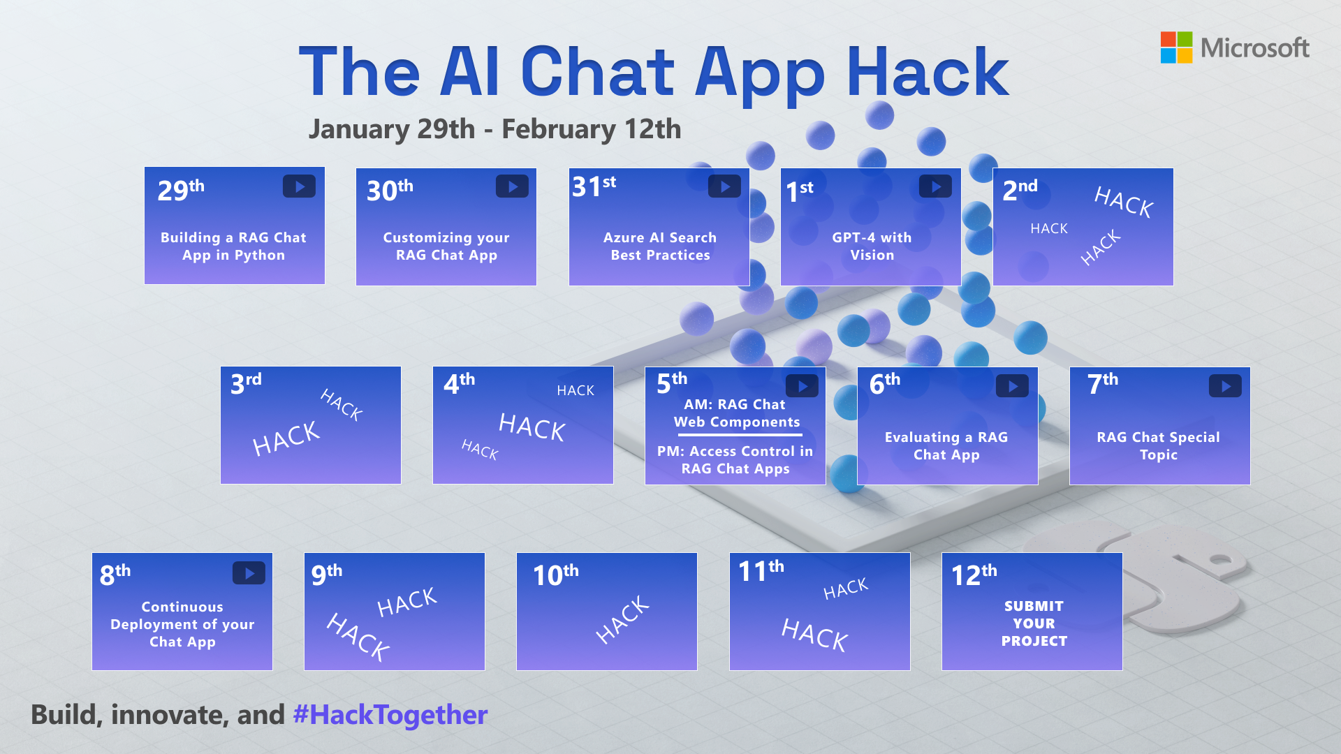

Slide 3

Building a RAG Chat App
with Azure AI Search, OpenAI, and Python 🐍

Slide 4
Goal
Build an AI Chat App using the RAG approach to combine an LLM with your own data.

Slide 5
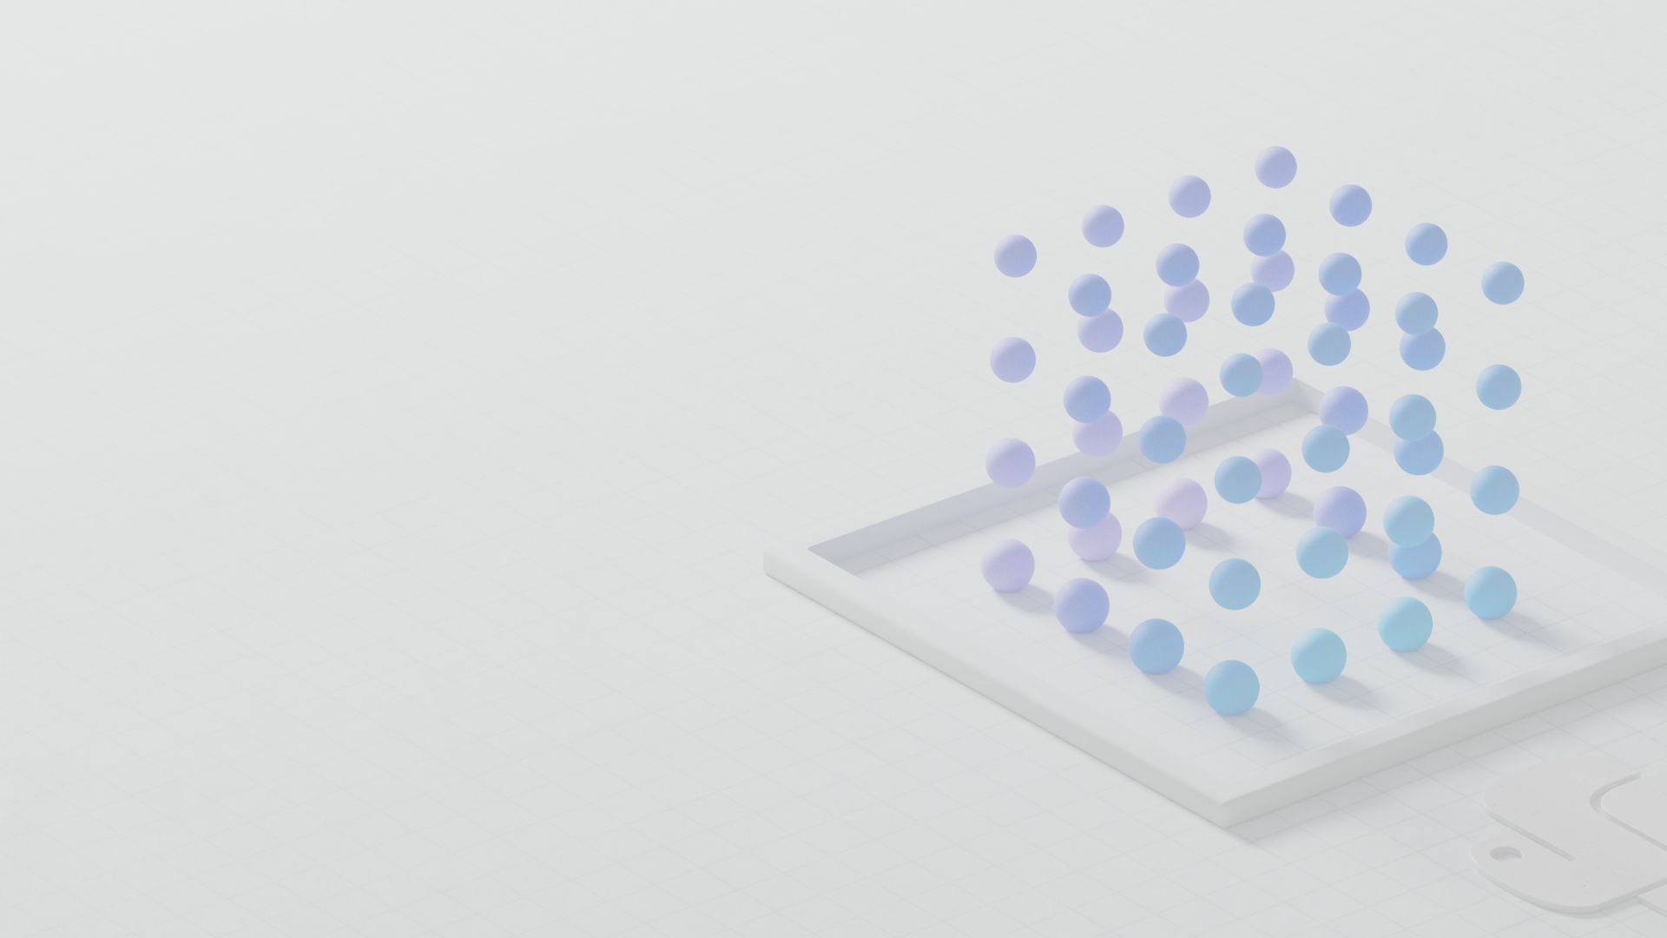
LLMs

Slide 6
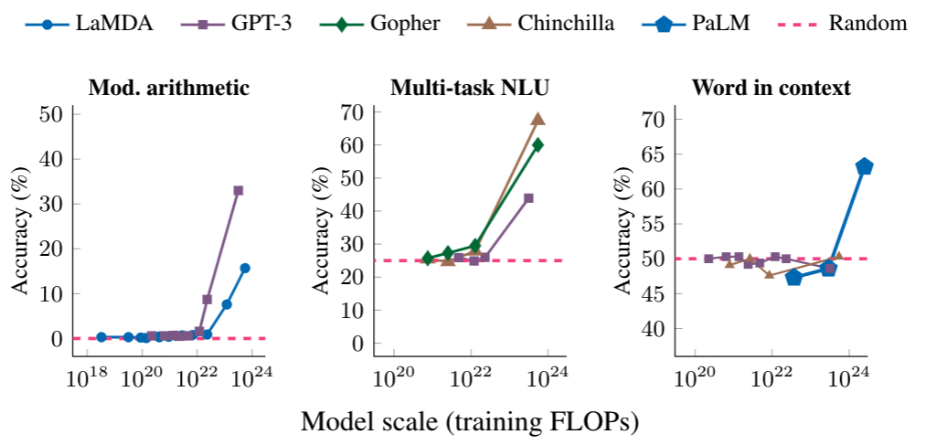
LLM: Large Language Model
An LLM is a model that is so large that it achieves general-purpose language understanding and generation.
Review: This movie sucks.
Sentiment: negative
Review: I love this movie:
Sentiment:
Input
LLM
Output
positive

Slide 7
LLMs in use today
Model | # of Parameters | Creator | Uses
GPT 3.5 | 175 B | OpenAI | ChatGPT, Copilots, APIs
GPT 4 | Undisclosed | OpenAI
PaLM | 540 B | Google | Bard
Claude 2 | 130 B | Anthropic | APIs
LlaMA | 70 B | Meta | OSS
Mistral-7B | 7 B | Mistral AI | OSS

Slide 8
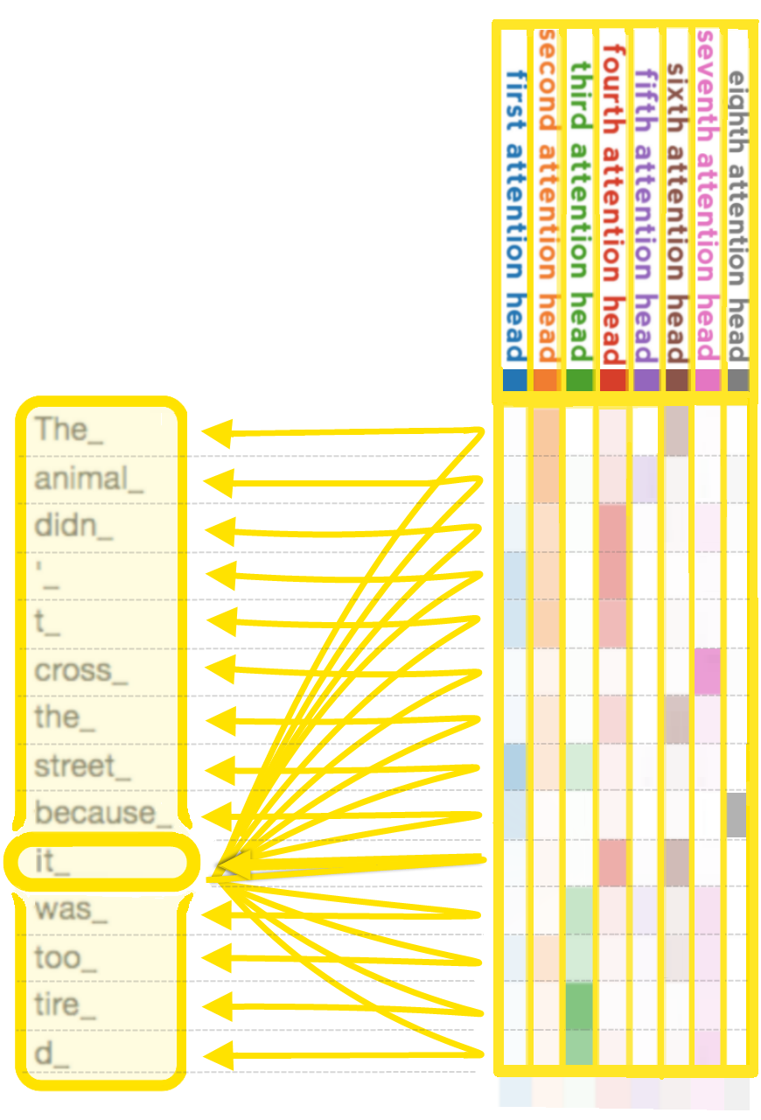
GPT: Generative Pre-trained Transformer
GPT models are LLMs based on Transformer architecture from "Attention is all you need" paper
Learn more:
Andrej Karpathy: 🎥 State of GPT
Andrej Karpathy: 🎥 Let's build GPT: from scratch, in code

Slide 9
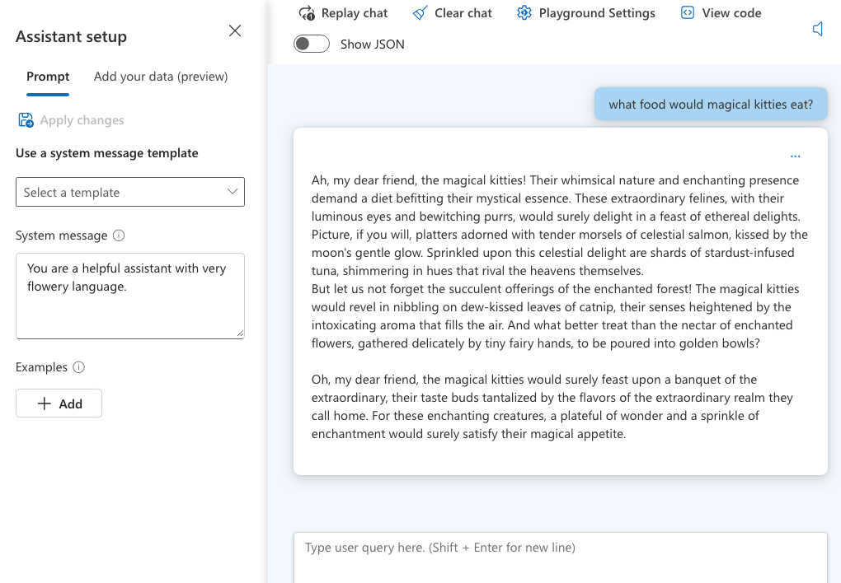
Using OpenAI GPT models: Azure Studio
System message
+
User question
=
Chat Completion response
Notes:
Also show openai.com playground

Slide 10
Using OpenAI GPT models: Python 🐍
response = openai.chat.completions.create(
stream=True,
messages = [
{
"role": "system",
"content": "You are a helpful assistant with very flowery language"
},
{
"role": "user",
"content": "What food would magical kitties eat?”
}
])
for event in response:
print(event.choices[0].delta.content)

Slide 11
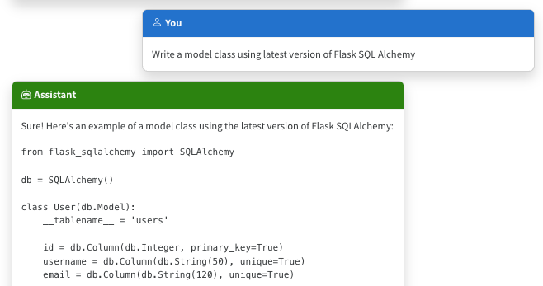
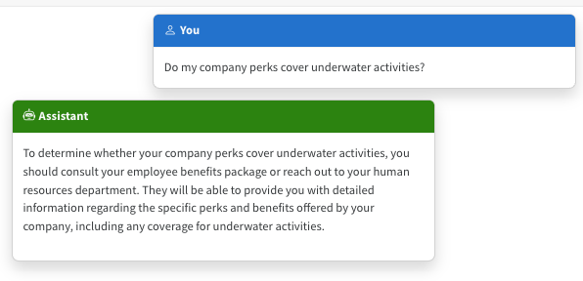
The limitations of LLMs
Outdated public knowledge
No internal knowledge

Slide 12
Incorporating domain knowledge
Prompt engineering
Fine tuning
Retrieval Augmented
Generation
In-context learning
Learn new skills
(permanently)
Learn new facts
(temporarily)

Slide 13
Retrieval Augmented Generation

Slide 14


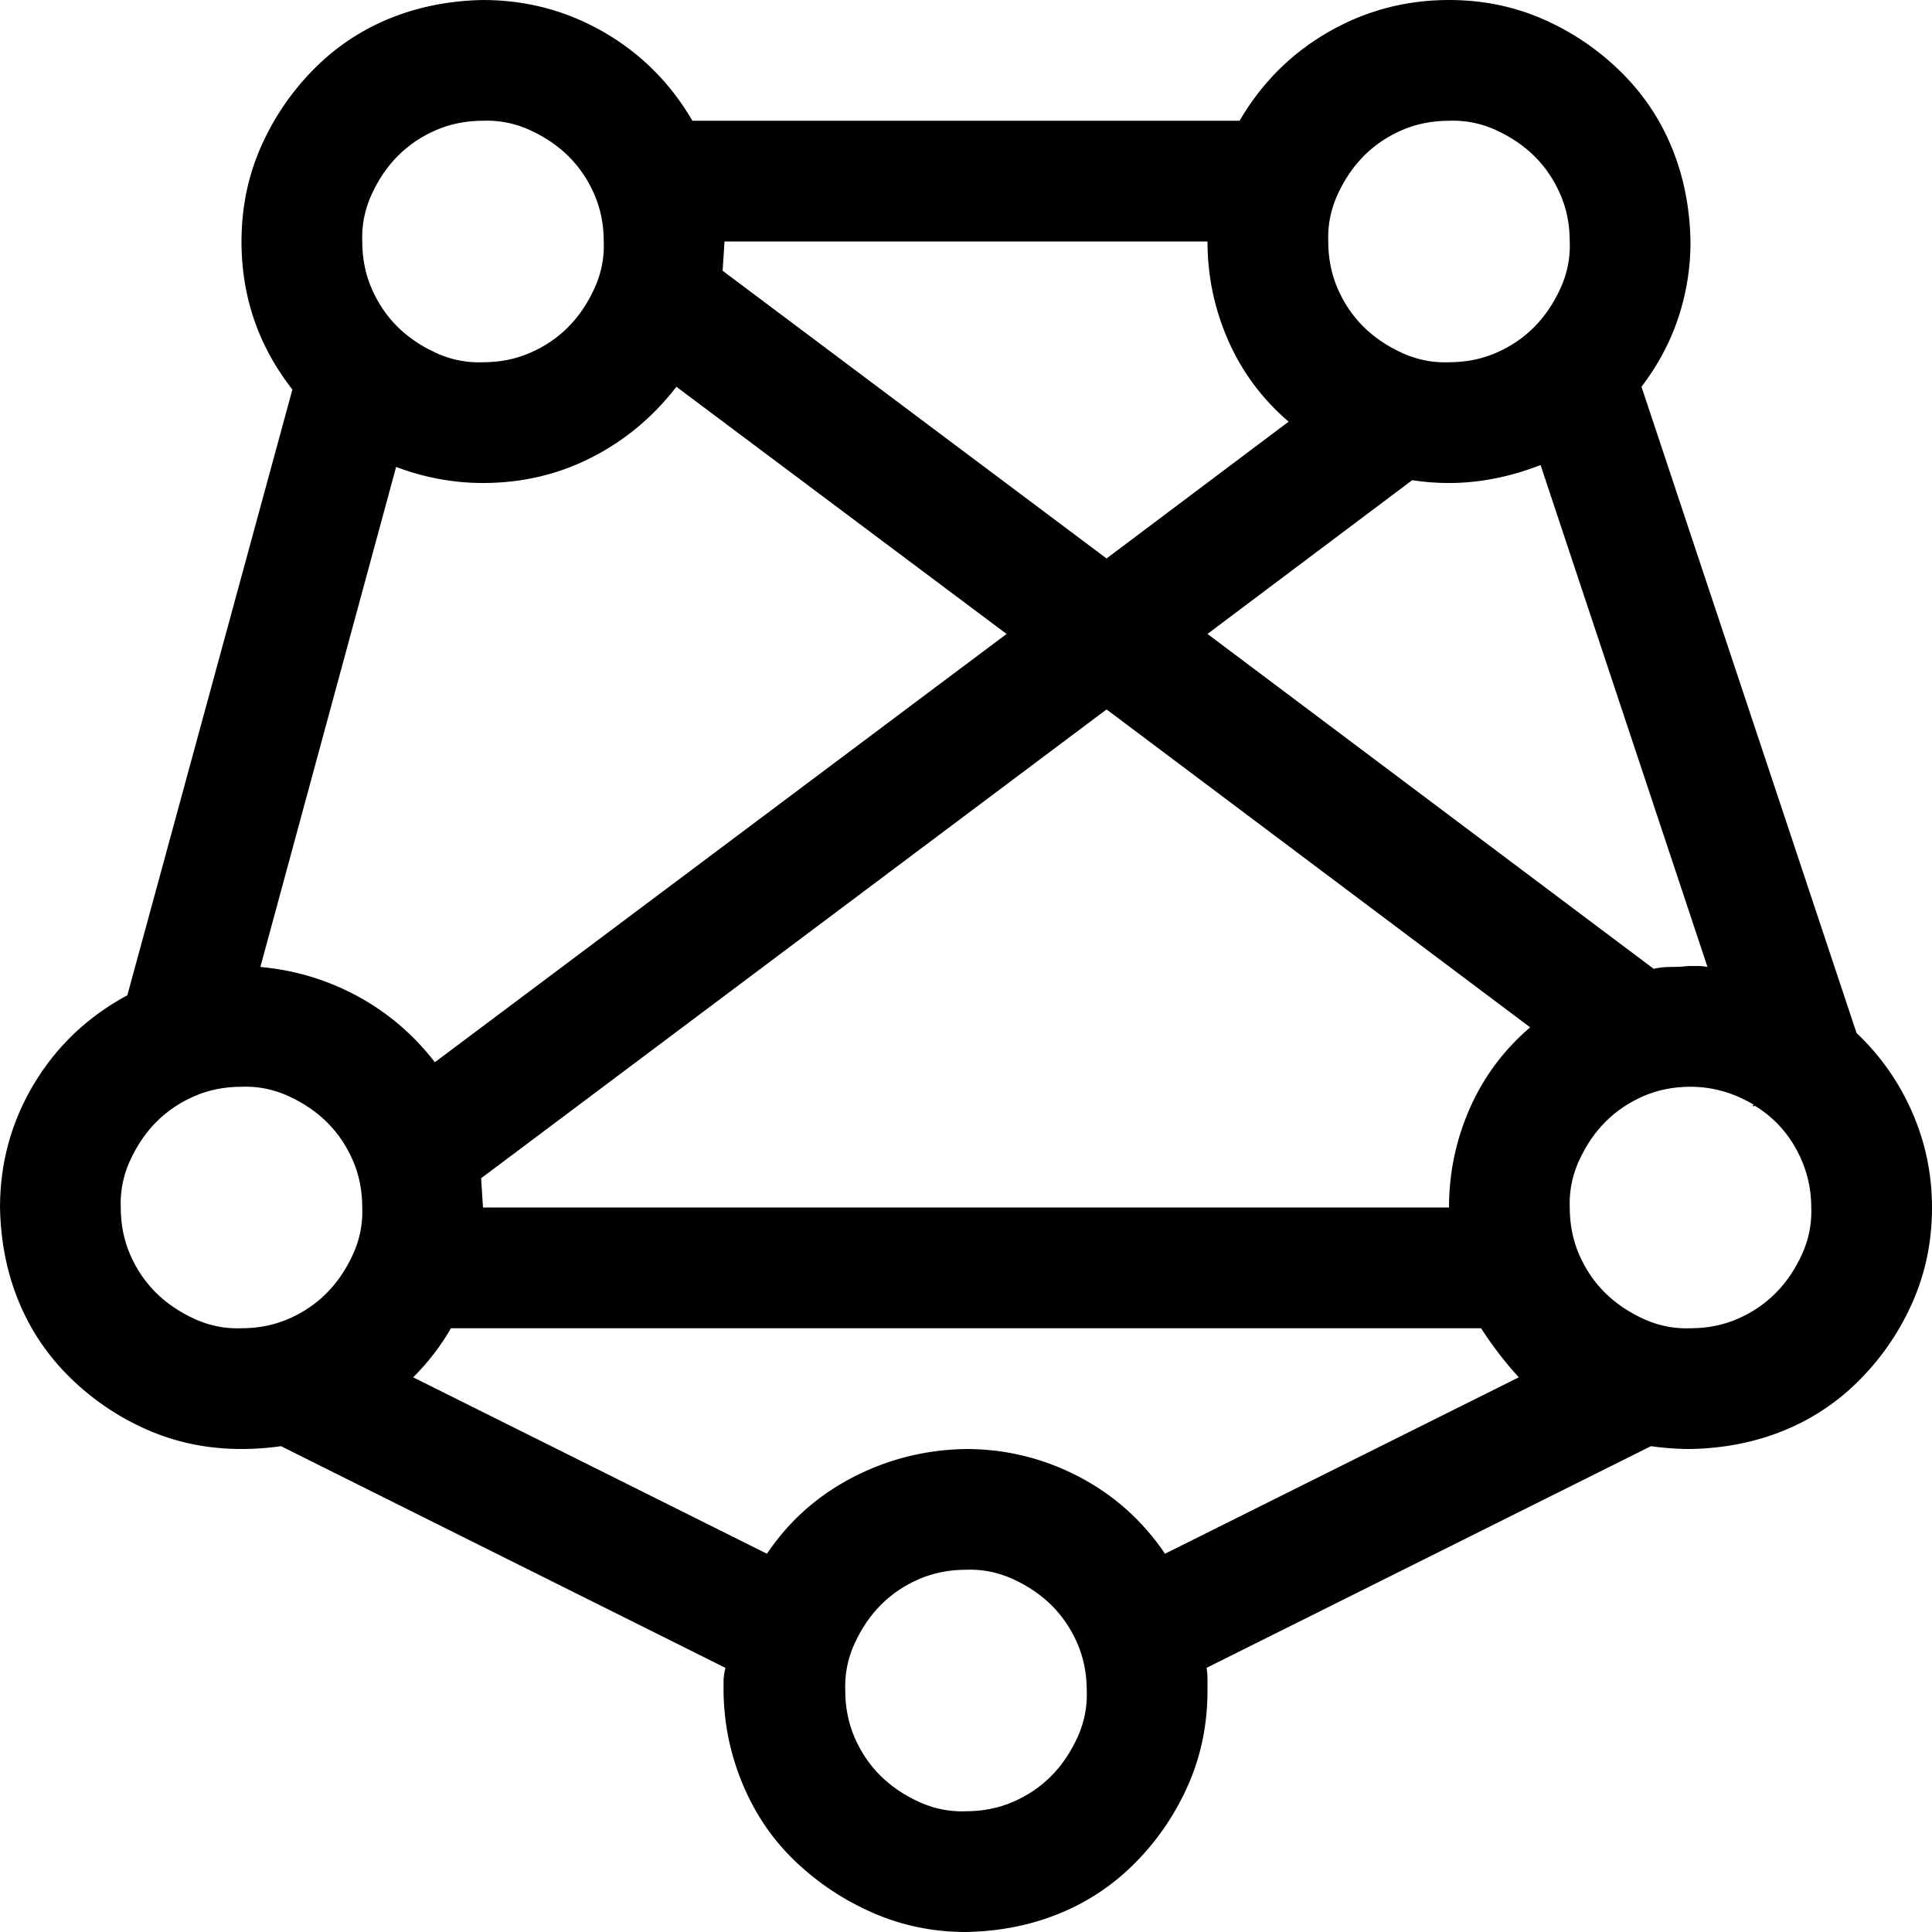

RAG: Retrieval Augmented Generation
Yes, your company perks cover underwater activities such as scuba diving lessons ¹
Do my company perks cover underwater activities?
PerksPlus.pdf#page=2: Some of the lessons covered under PerksPlus include: · Skiing and snowboarding lessons · Scuba diving lessons · Surfing lessons · Horseback riding lessons These lessons provide employees with the opportunity to try new things, challenge themselves, and improve their physical skills.….
User
Question
Document Search
Large Language Model
Notes:
Show RAG chat app with thought process that shows the steps. Start with Ask tab for simplicity.

Slide 15
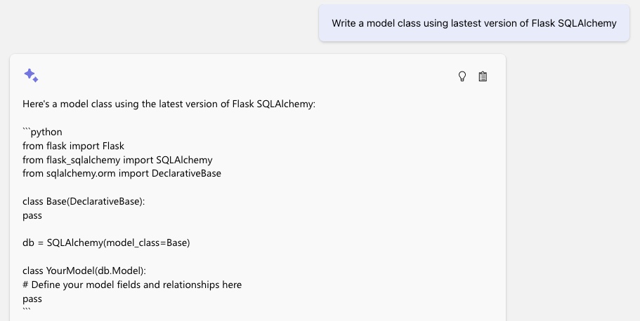
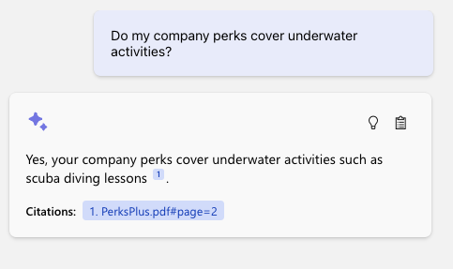
The benefit of RAG
Up-to-date public knowledge
Access to internal knowledge

Slide 16
RAG components
Component | Examples
Retriever: A knowledge base that can efficiently retrieve sources that match a user query | Azure AI Search, Azure CosmosDB, PostgreSQL, Qdrant, Pinecone
LLM: A model that can answer questions based on the query based on the provided sources, and can include citations | GPT 3.5, GPT 4
Glue: A way to chain the retriever to the LLM (optional) | Langchain, Llamaindex, Semantic Kernel
Features | Chat history, Feedback buttons, Text-to-speech, User login, File upload, Access control, etc.

Slide 17
Many ways to build a RAG chat app
github.com/
azure-search-openai-demo
Copilot studio
Azure Studio On Your Data
No Code Low Code High Code

Slide 18
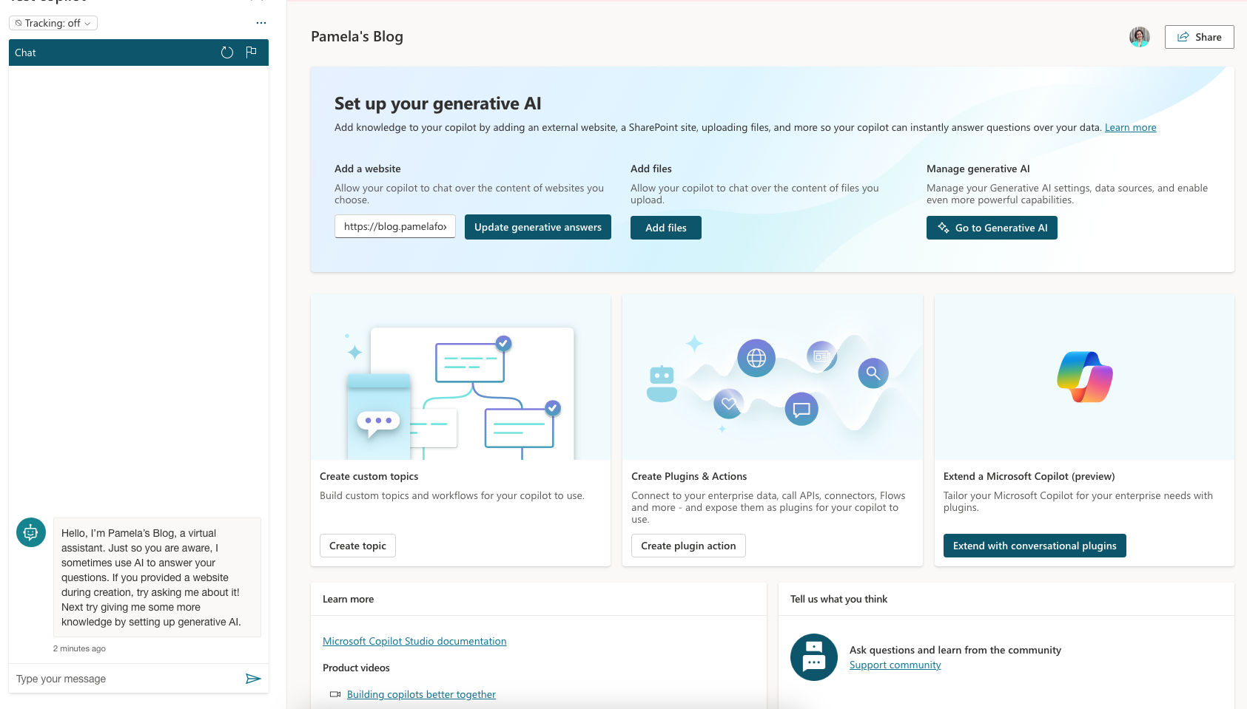
Copilot Studio – On Your Data
Retriever:
Uploaded files
LLM: GPT 3.5
https://copilotstudio.preview.microsoft.com/

Slide 19
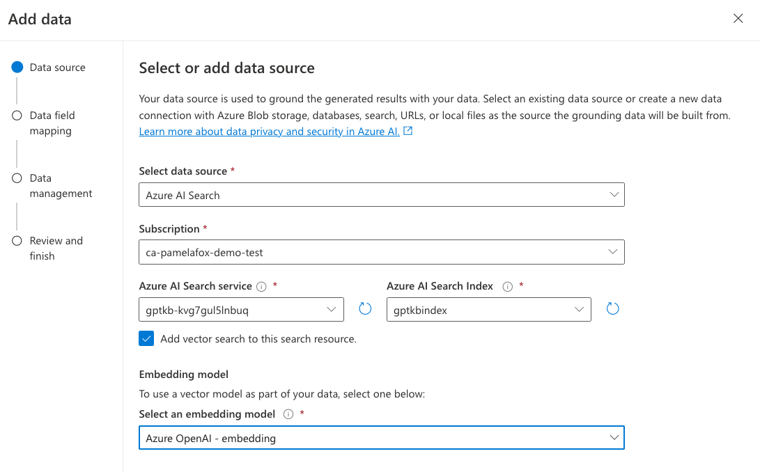
Azure Studio – On Your Data
Retriever:
Azure AI Search
Azure Blob Storage
Azure CosmosDB for MongoDB vCore
URL/Web address
Uploaded files
LLM: GPT 3.5/4
Features:
User authentication
Chat history persistence
https://learn.microsoft.com/azure/ai-services/openai/concepts/use-your-data

Slide 20
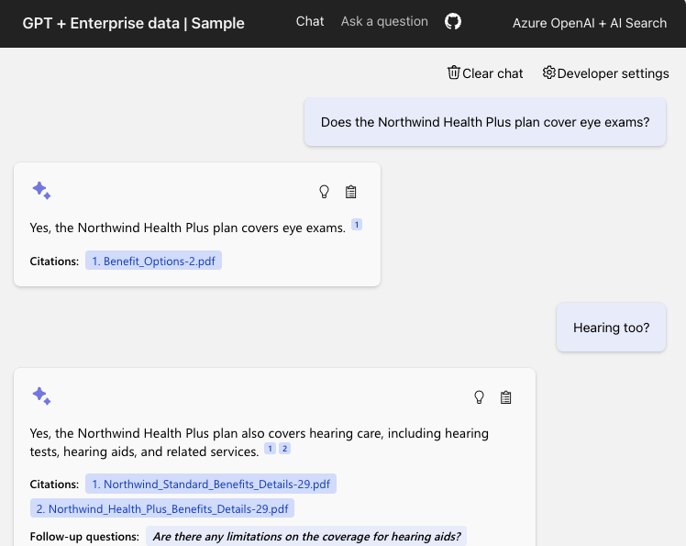
Open source RAG chat app solution
Retriever:
Azure AI Search
LLM: GPT 3.5/4
Features:
Multi-turn chats
User authentication with ACLs
Chat with image documents
🔗 https://github.com/Azure-Samples/azure-search-openai-demo/ aka.ms/ragchat

Slide 21
Deep dive:
RAG chat app solution

Slide 22
Prerequisites
Azure account and subscription
A free account can be used, but will have limitations.
Access to Azure OpenAI or an openai.com account
Request access to Azure OpenAI today! https://aka.ms/oaiapply
Azure account permissions:
Microsoft.Authorization/roleAssignments/write
Microsoft.Resources/deployments/write on subscription level
https://github.com/Azure-Samples/azure-search-openai-demo/#azure-account-requirements

Slide 23
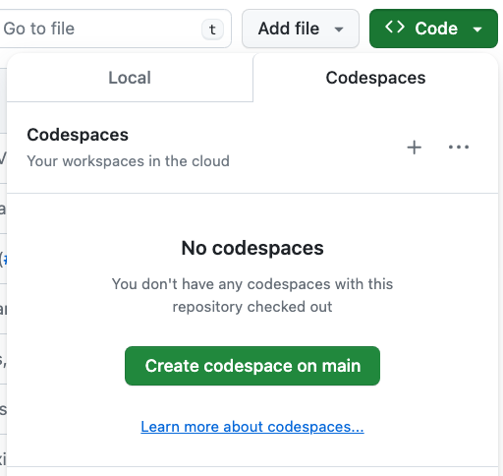
Opening the project: 3 options
GitHub Codespaces →
VS Code with Dev Containers extension
Your Local Environment
Python 3.9+
Node 14+
Azure Developer CLI
https://github.com/Azure-Samples/azure-search-openai-demo/?tab=readme-ov-file#project-setup

Slide 24
Deploying with the Azure Developer CLI
Login to your Azure account:
azd auth login --use-device-code
Create a new azd environment: (to track deployment parameters)
azd env new
Provision resources and deploy app:
azd up
azd up is a combination of azd provision and azd deploy

Slide 25






Application architecture on Azure
DATA INGESTION
Integrated vectorization
or
Local script
Azure Storage
Document
Intelligence
Python
Azure OpenAI
Azure
AI Search
Uploads PDF pages
Extracts data from PDFs
Splits data
into chunks
Computes embeddings
Stores in index
Azure
App Service
or
Local server
CHAT APP
Azure Storage
Azure OpenAI
Azure
AI Search

Slide 26
Code walkthrough
Typescript frontend
(React, FluentUI)
Python backend
(Quart, Uvicorn)
chat.tsx
makeApiRequest()
api.ts
chatApi()
app.py
chat()
chatreadretrieveread.py
run()
get_search_query()
compute_text_embedding()
search()
get_messages_from_history()
chat.completions.create()

Slide 27
Search approach
For optimal retrieval, search() uses hybrid retrieval (text + vectors) plus the semantic ranker option.
Reranking
Fusion (RRF)
https://aka.ms/ragrelevance
Vector
Keywords
📣 Learn more at this week’s session: Azure AI Search Best Practices

Slide 28
Next steps
Register for the hackathon →
Introduce yourself in our discussion forum
Deploy the repo with the sample data
See steps on low cost deployment →
Post in forum if you have any questions or issues deploying.
Join tomorrow’s session: Customizing your RAG Chat App!
aka.ms/hacktogether/chatapp
aka.ms/ragchat/free

